Slide 1

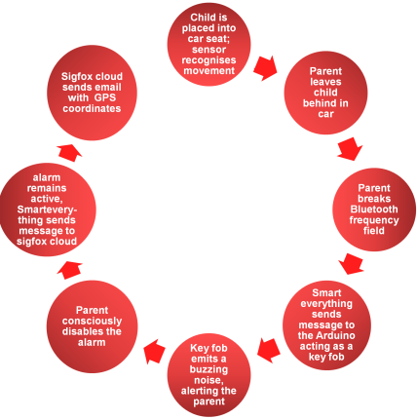
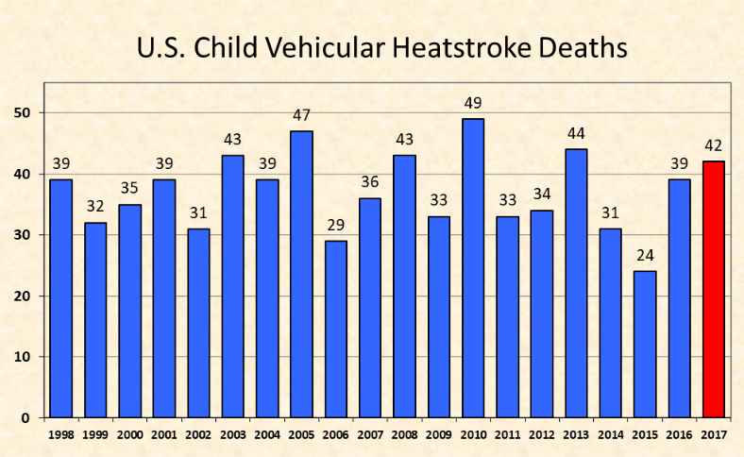
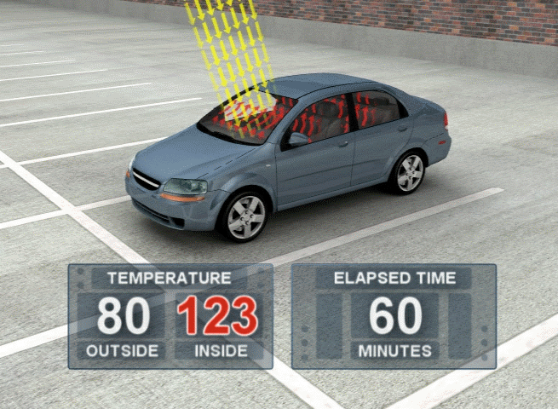
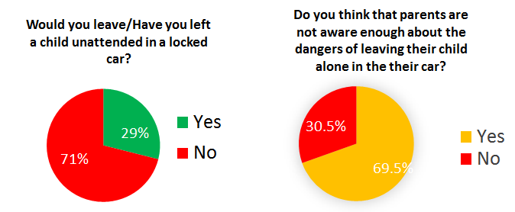

Baby on Board A device that prevents hot car deaths
Temperature
Outside Inside Elapsed Time
26.6 ℃ 50.5℃ 60 Minutes
Claire Cooney & Ellen Murphy
Laurel Hill Secondary School FCJ, South Circular Road, Limerick
References 1: https://www.babyalert.info/ 2 http://noheatstroke.org/

